Slide 1
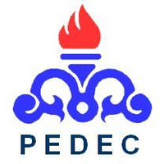

Petroleum Engineering and Development Company
PEDEC
October 2018

Slide 2
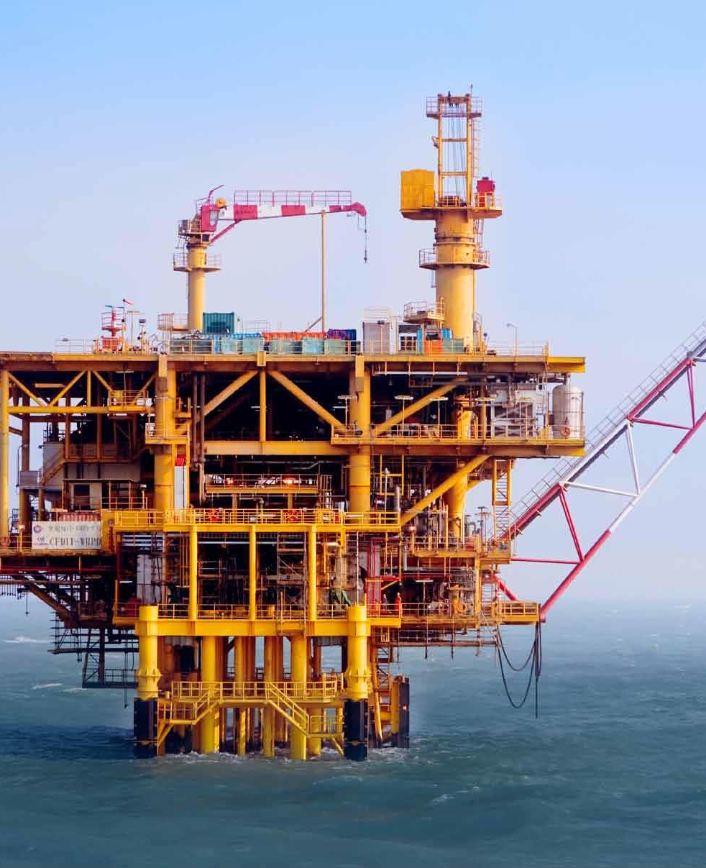
About Us
Petroleum Engineering and Development Company (PEDEC) was established in 1994 aiming at supervising the engineering and development of projects by planning, engineering, constructing, and implementing giant oil and gas projects at National Iranian Oil Company (NIOC).
PEDEC, as the development arm of NIOC, studies and operates development projects to explore, extract, and produce crude oil, natural gas to meet NIOC’s requirements, improve upstream technology, and make the most of local sources in implementation of projects.
To implement a large number of onshore and offshore projects, PEDEC is working with many engineering and contracting companies both within and outside the country’s borders. The company, thereby, provides a platform for the transfer of technology in oil and gas related projects and ushers in an era of technology self-sufficiency in Iran.

Slide 3
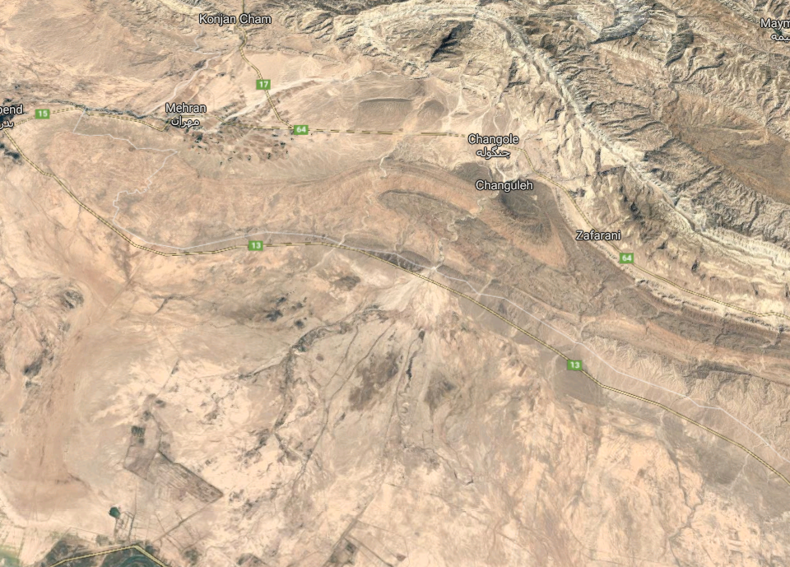
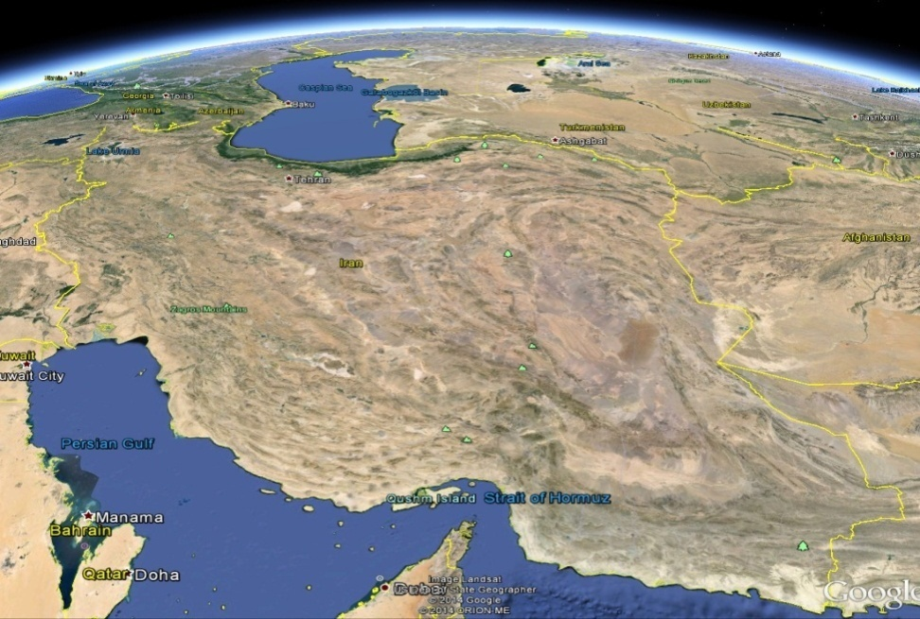
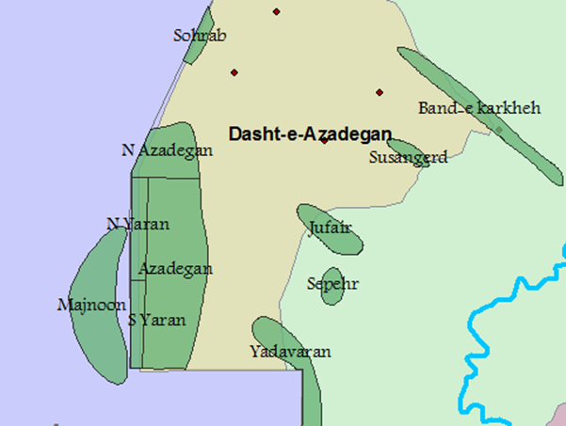
Location of Ongoing Project
Azar
Changuleh
Iran
Iraq

Slide 4
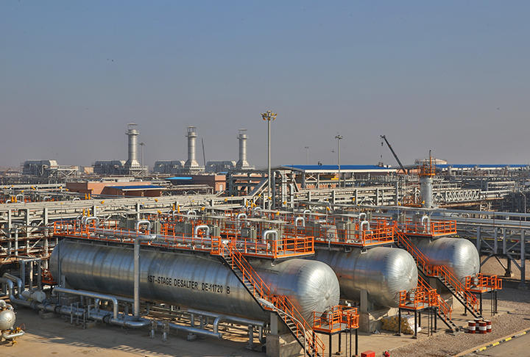
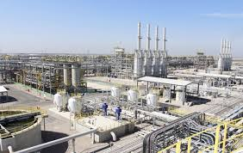
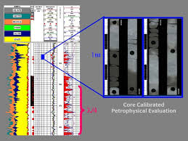
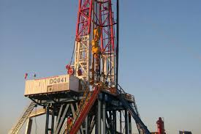
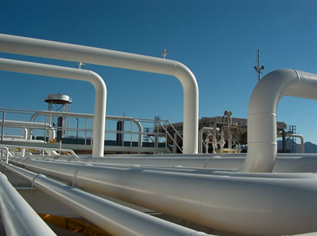
Development Project of South Azadegan Oil Field
Phase 1: daily production of 320,000 barrels of crude oil
Phase 2: daily production of 280,000 barrels of crude oil
Development Project of North Azadegan Oil Field
Phase 1: Daily production of 75,000 barrels of crude oil
Phase 2: Daily production of 150,000 barrels of crude oil
Development Project of Yadavaran Oil Field
Phase 1: to reach a daily production of 85,000 barrels of crude oil.
Phase 2: to reach a daily production of 180,000 barrels of crude oil
Development Project of North Yaran Oil Field
Phase 1: Daily production of 20,000 barrels of crude oil
Development Project of South Yaran Oil Field
Phase 1: Daily production of 25,000 barrels of crude oil
Development Project of Azar Oil Field
Phase 1: Daily production of 65,000 barrels of crude oil
Development Project of Changuleh Oil Field
Phase 1: Daily production of 60,000 barrels of crude oil

Slide 5
Challenges in West Karoon and Anaran Oilfield
Reservoir Base
Drilling Base
Well Positioning without reliable model
Rock and Fluid Heterogeneity
Weak Connection of Reservoir and Wellbore
Precipitation of Solid Particles
Weak Connection between Reservoir and Wellbore
Improper Stimulation
Lack of Horizontal Completion
Slotted Liner plays as a barrier

Slide 6

Technology Demands
Requested Technologies
Design an Intelligent Stimulation technique
Design a Hydraulic Fracturing or BM
Design a 3D Geomechanical Model
Horizontal PLT & Horizontal Completion Technology
Insitu Upgrading of Heavy Oil
Design of Asphaltene Treatment Package
Solar Lighting Panel
Geo-steering Drilling Technology

Slide 7

Thank You.
PEDEC
Hojjat Noruzi
+98-9122301102
hnurozi@yahoo.ca
www.pedec.ir

Slide 8
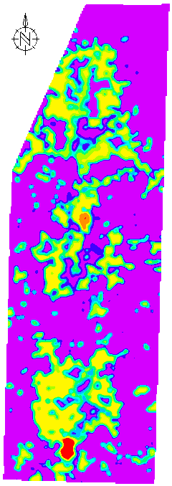
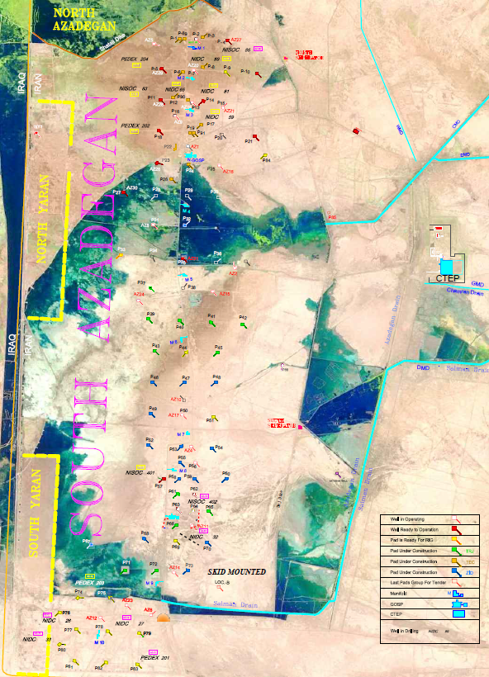

Slide 9
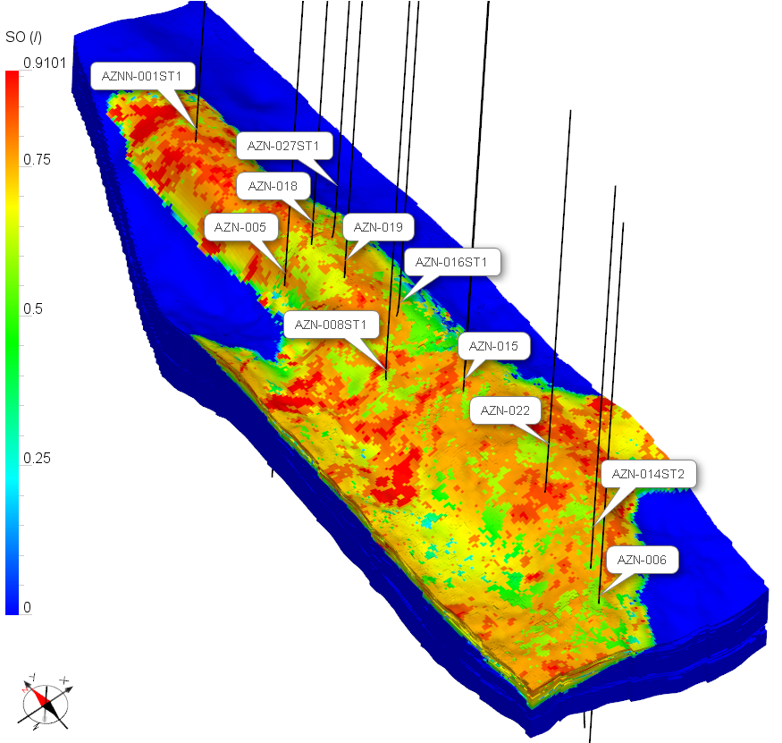
Solution
Update the Integrated reservoir model with new data
Use updated model for future well location

Slide 10
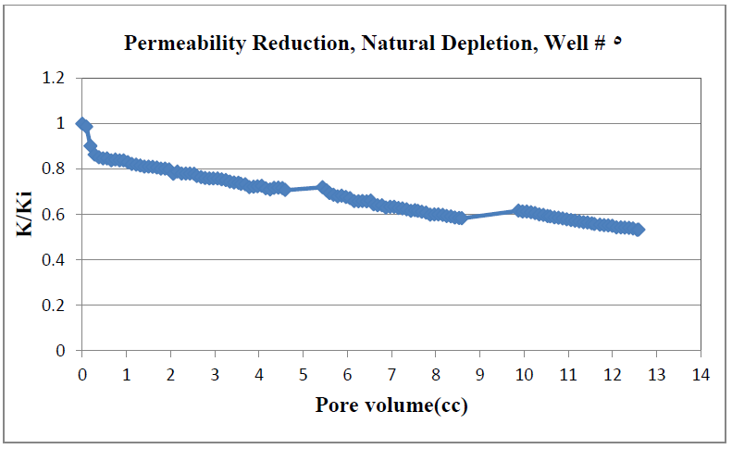
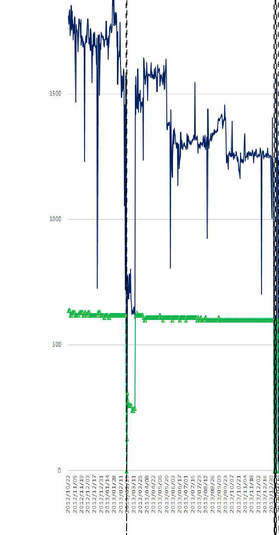
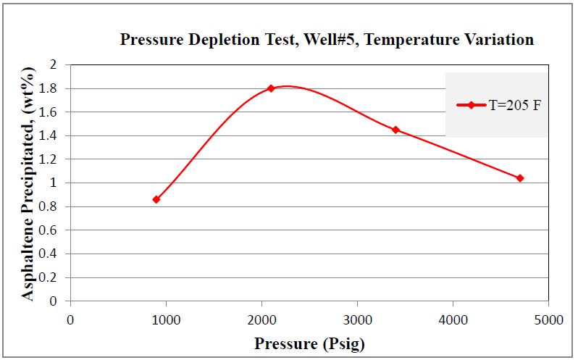
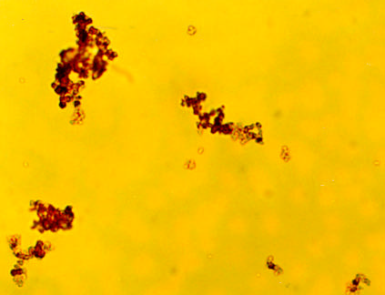

Slide 11
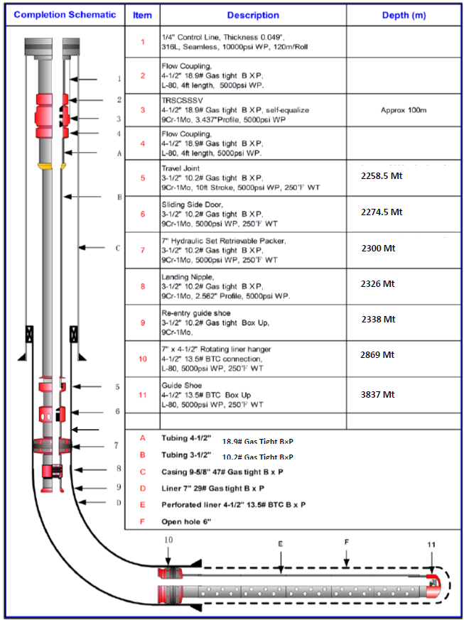
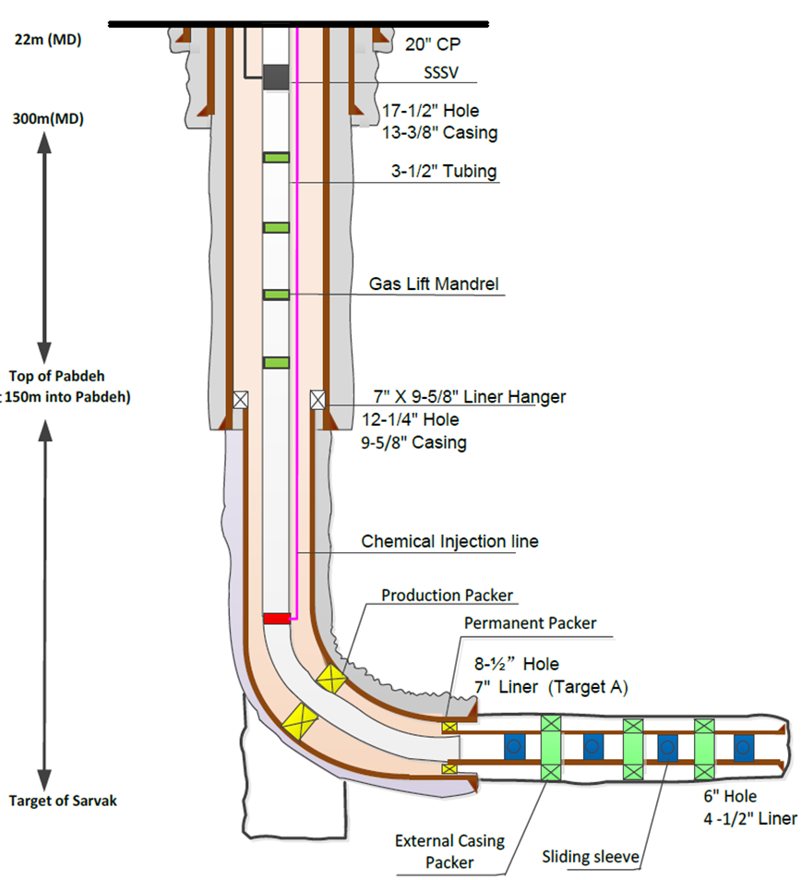
Solution:
Perform HF in Horizontal section
Use horizontal completion
Inflow Control Valve

Slide 12
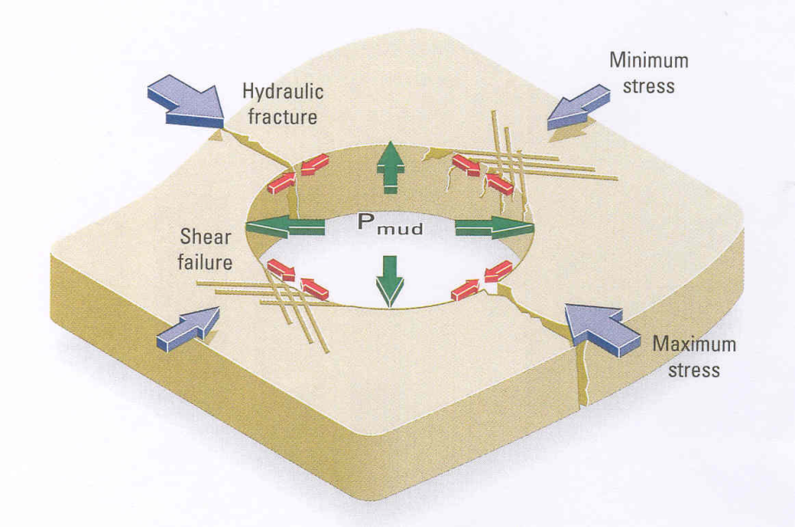
Geomechanical study gives:
1- 3D initial field stress, pore pressure depletion and rock property change
2- The stability of the wellbore for open hole completion or hydraulic fracturing design
Solution:
Construction of 1D-MEM and 3D Geomechanical model
Use the 3D geo-model for determining Azimuth of future wells

